Slide 1
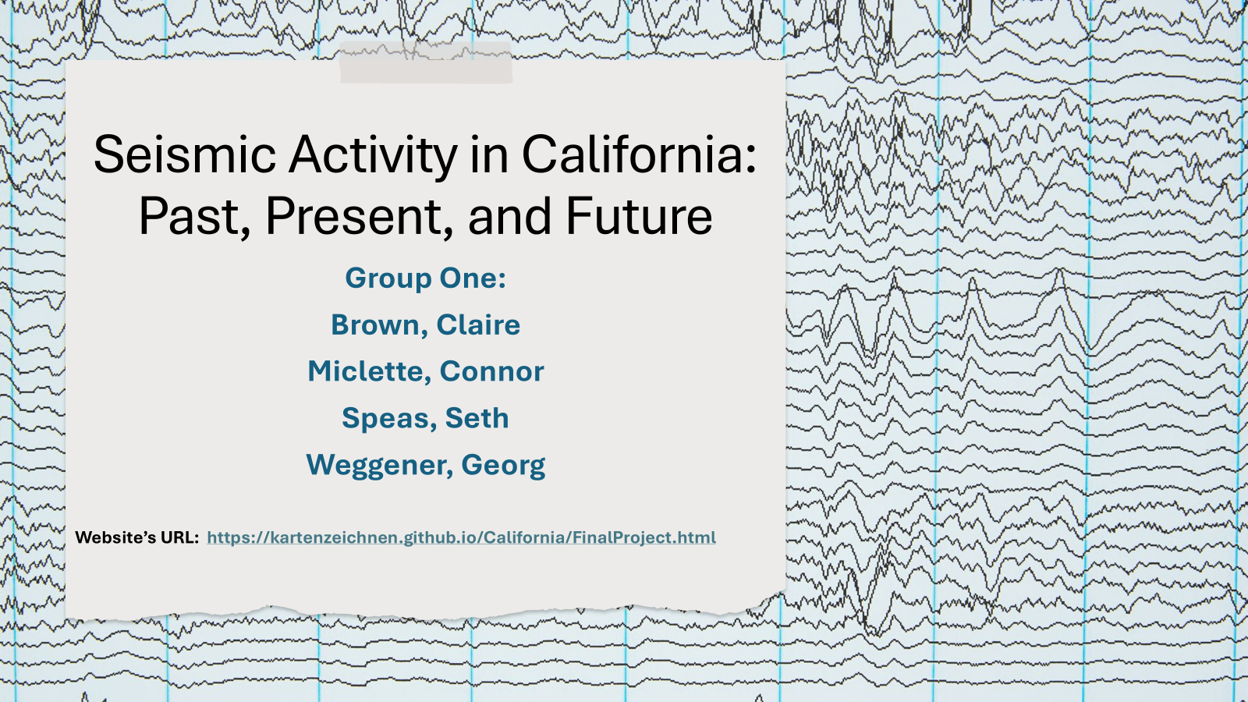

Slide 2
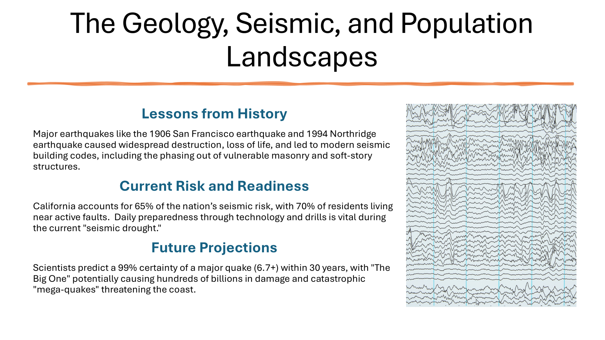

Slide 3
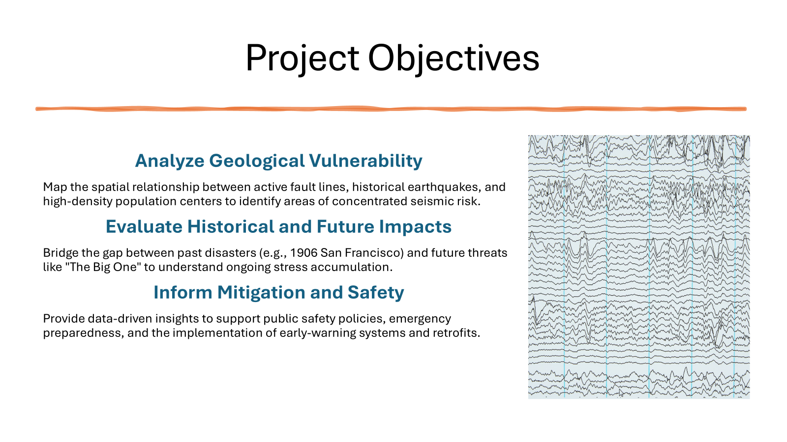

Slide 4
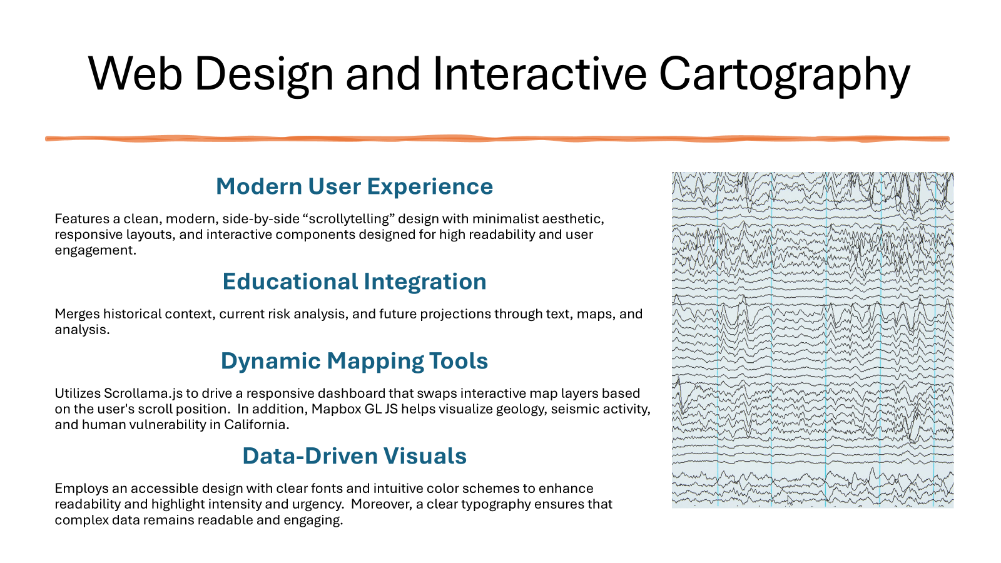

Slide 5
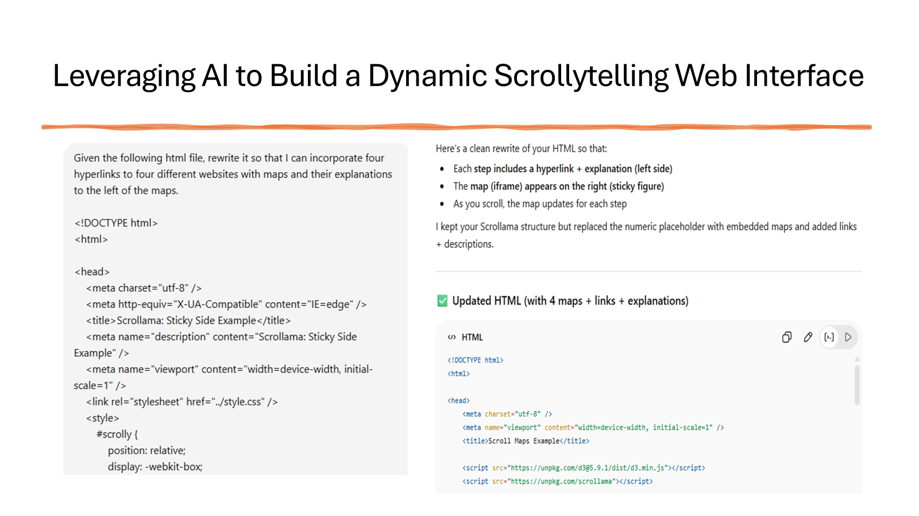
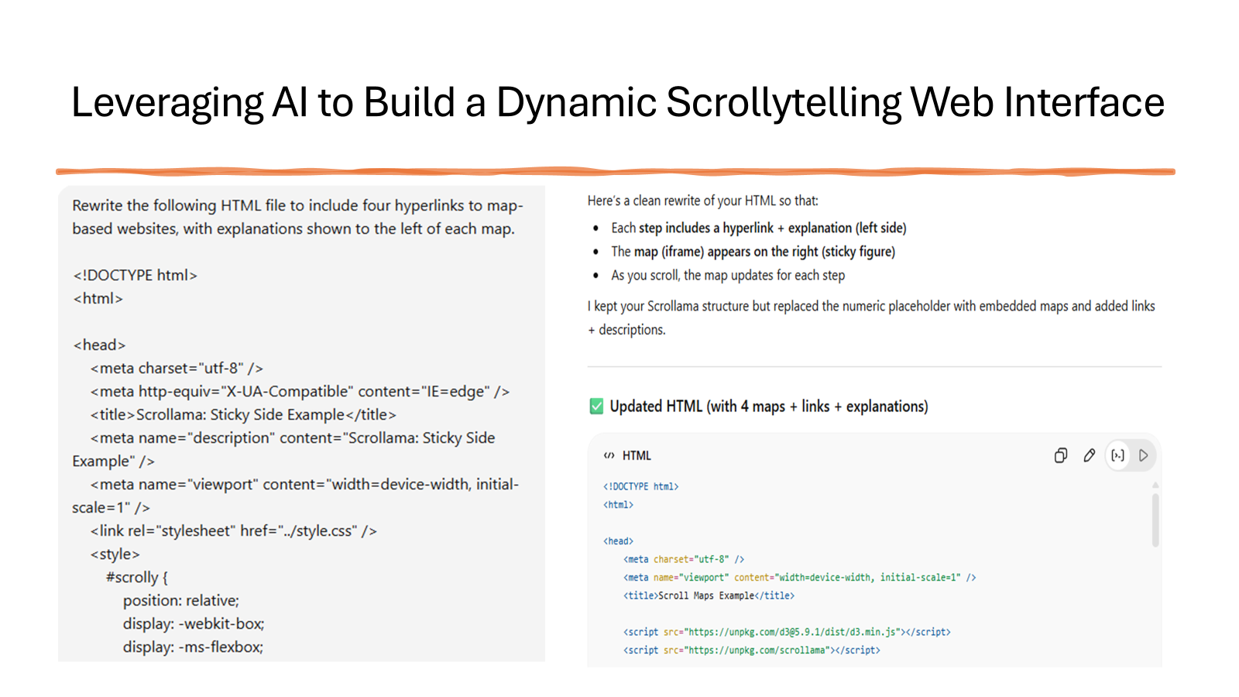
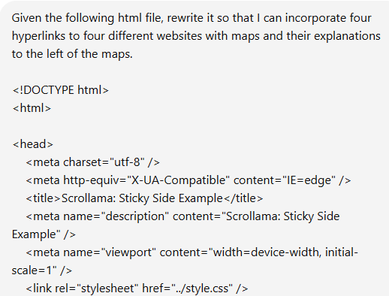
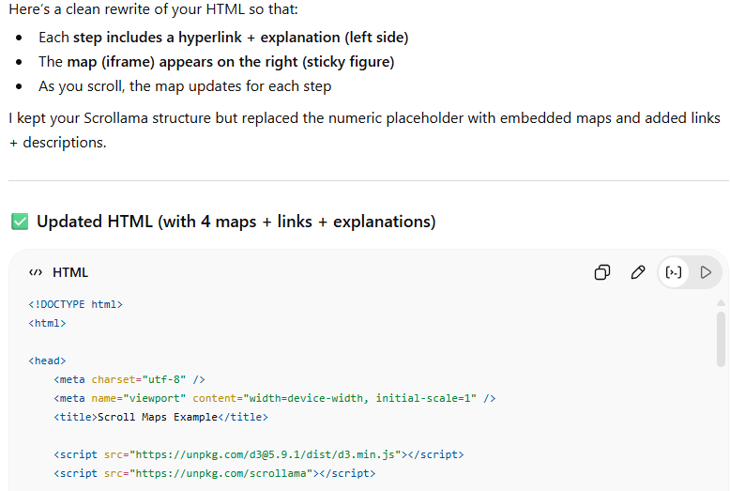
Leveraging AI to Build a Dynamic Scrollytelling Web Interface

Slide 6
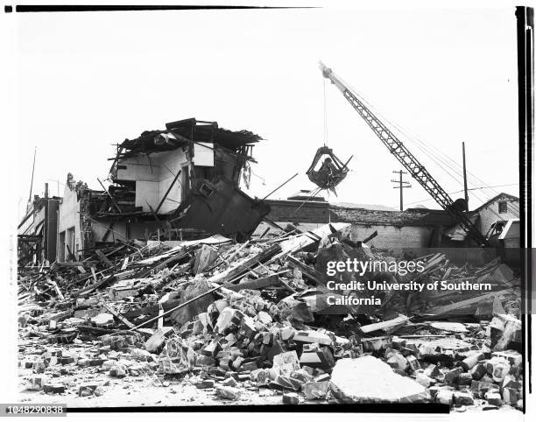
1952 Kerns County 7.3
I wanted my population data to show the volume of people affected by earthquakes. The population data provides the bridge between the earthquake data and the monetary cost data.
I found what I wanted with California State Geoportal.
Important things I learned:
search should include shapefile
be persistent
be flexible
The HTML file was a challenge.
I used AI to help build the HTML file and add the circles and popups.
Copilot didn’t work I had success with Chatbox GPT.
Important things I learned:
Need help, ASK
Save early and save often
Be patient
12 killed, 3 shocks greater than 6 over the next five days

Slide 7


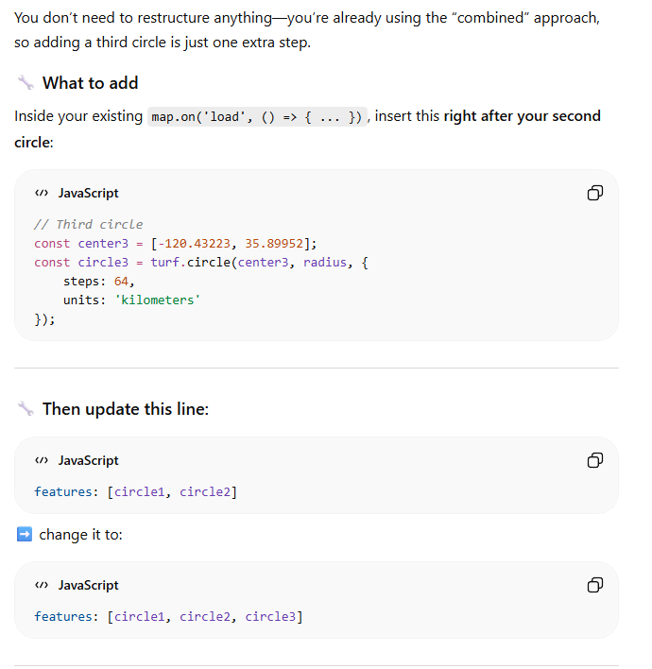
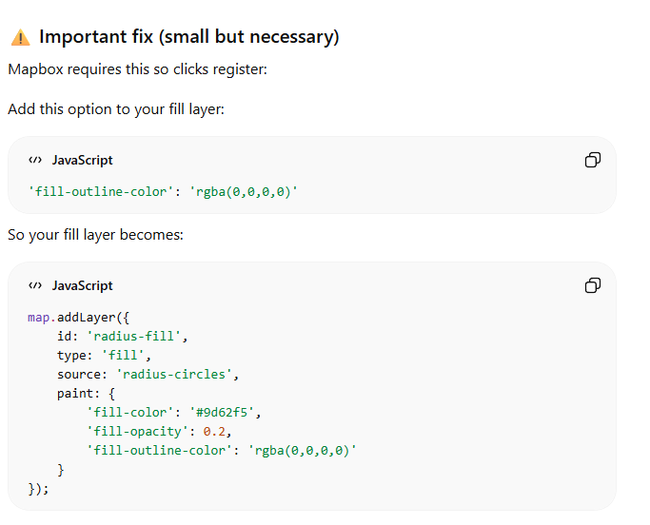
AI - Words Matter

Slide 8
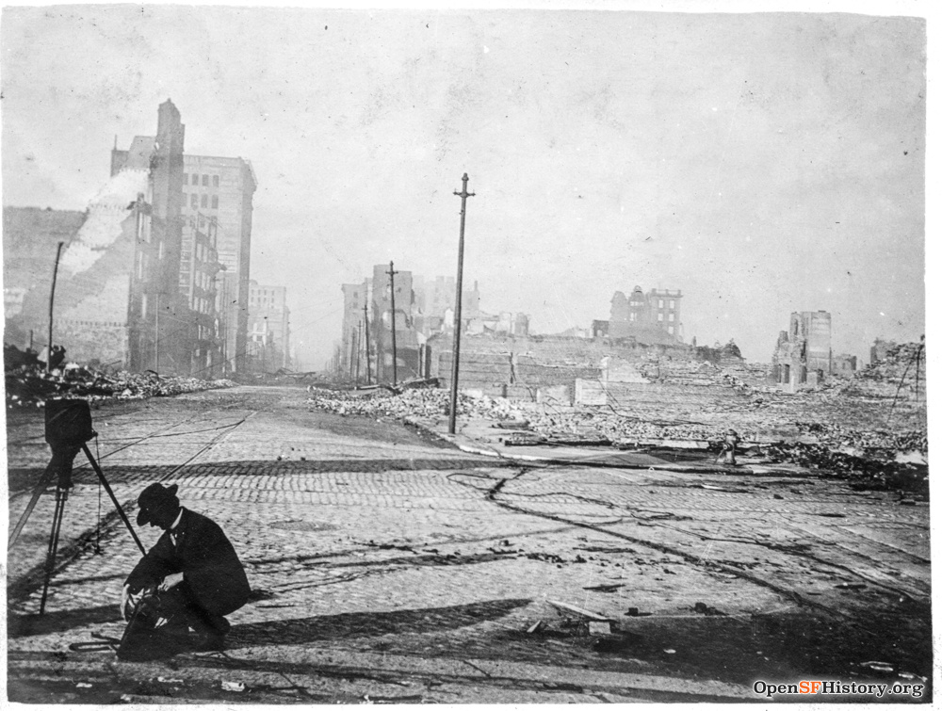
1906 San Francisco Earthquake 7.8
Mapbox and Tilesets
Finding compatible data
Hosting on MapBox via Github
Approximately 3,000 killed and 225,000 displaced
https://www.opensfhistory.org/Photoset/1906_Earthquake

Slide 9
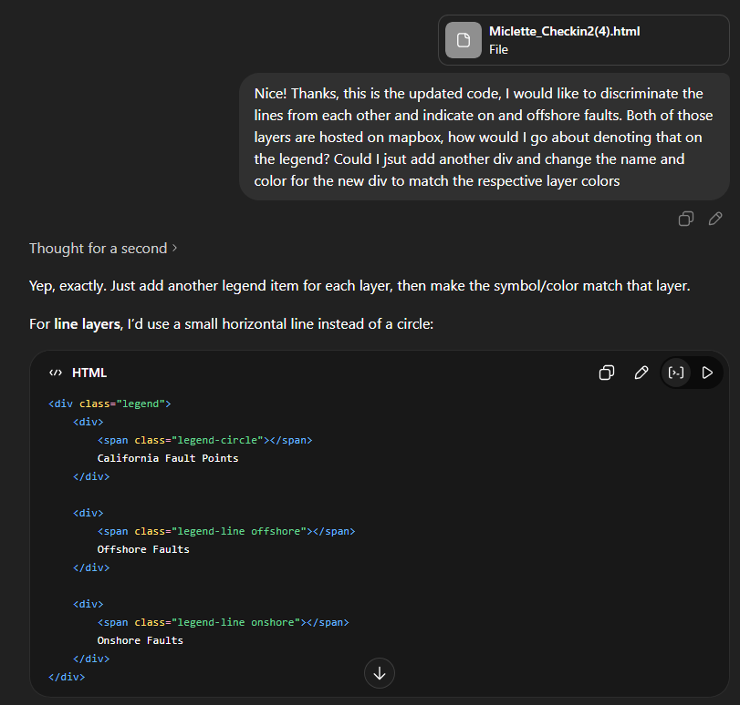
AI Enabled Vibe Coding and MapBox
A steep learning curve:
Learning to code with AI
ChatGPT learning curve
Editing code with ChatGPT
MapBox
Publishing revisions
Finding compatible data sets

Slide 10
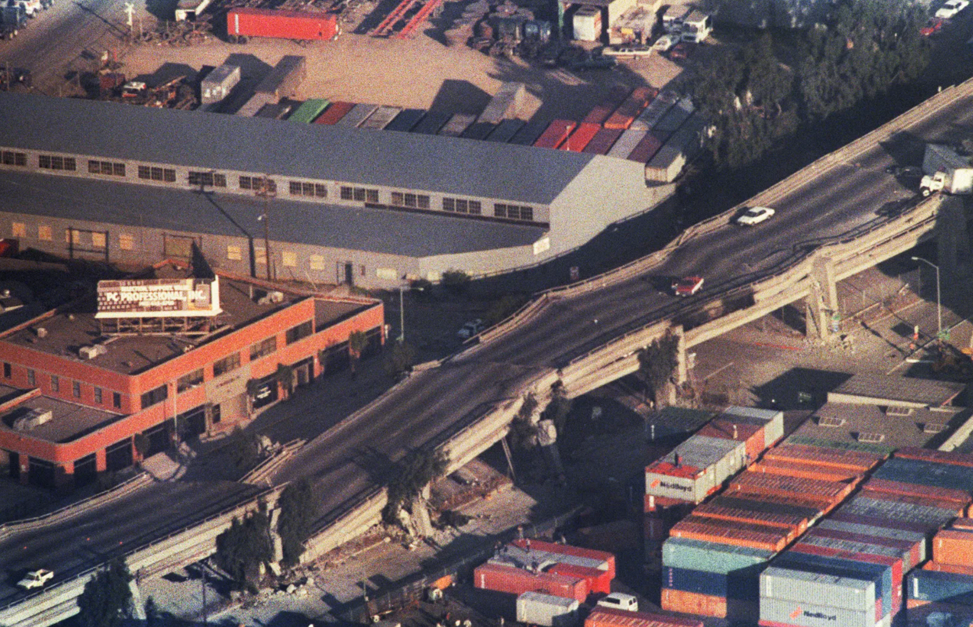
1989 Bay Area 6.9
Goals of the Map:
Interactive
Display Severity
Show specific County losses from Earthquakes in $USD amount
Mapping Challenges:
Data acquisition
Data conversion
Mapbox styles not cooperating
Use of AI and References:
https://claude.ai/share/9f79f00a-a461-48fc-aae2-e8819822c7ae
“Map Sheet 48 (2025 Update) - Annualized Earthquake Loss.” California State Geoportal, gis.data.ca.gov/datasets/cadoc::map-sheet-48-2025-update-annualized-earthquake-loss-1/about?layer=0. Accessed 29 Apr. 2026.
63 killed, 3,753 injured, and 10 billion dollars in damage
https://www.ocregister.com/2017/10/16/photos-the-1989-loma-prieta-earthquake-a-look-back/

Slide 11
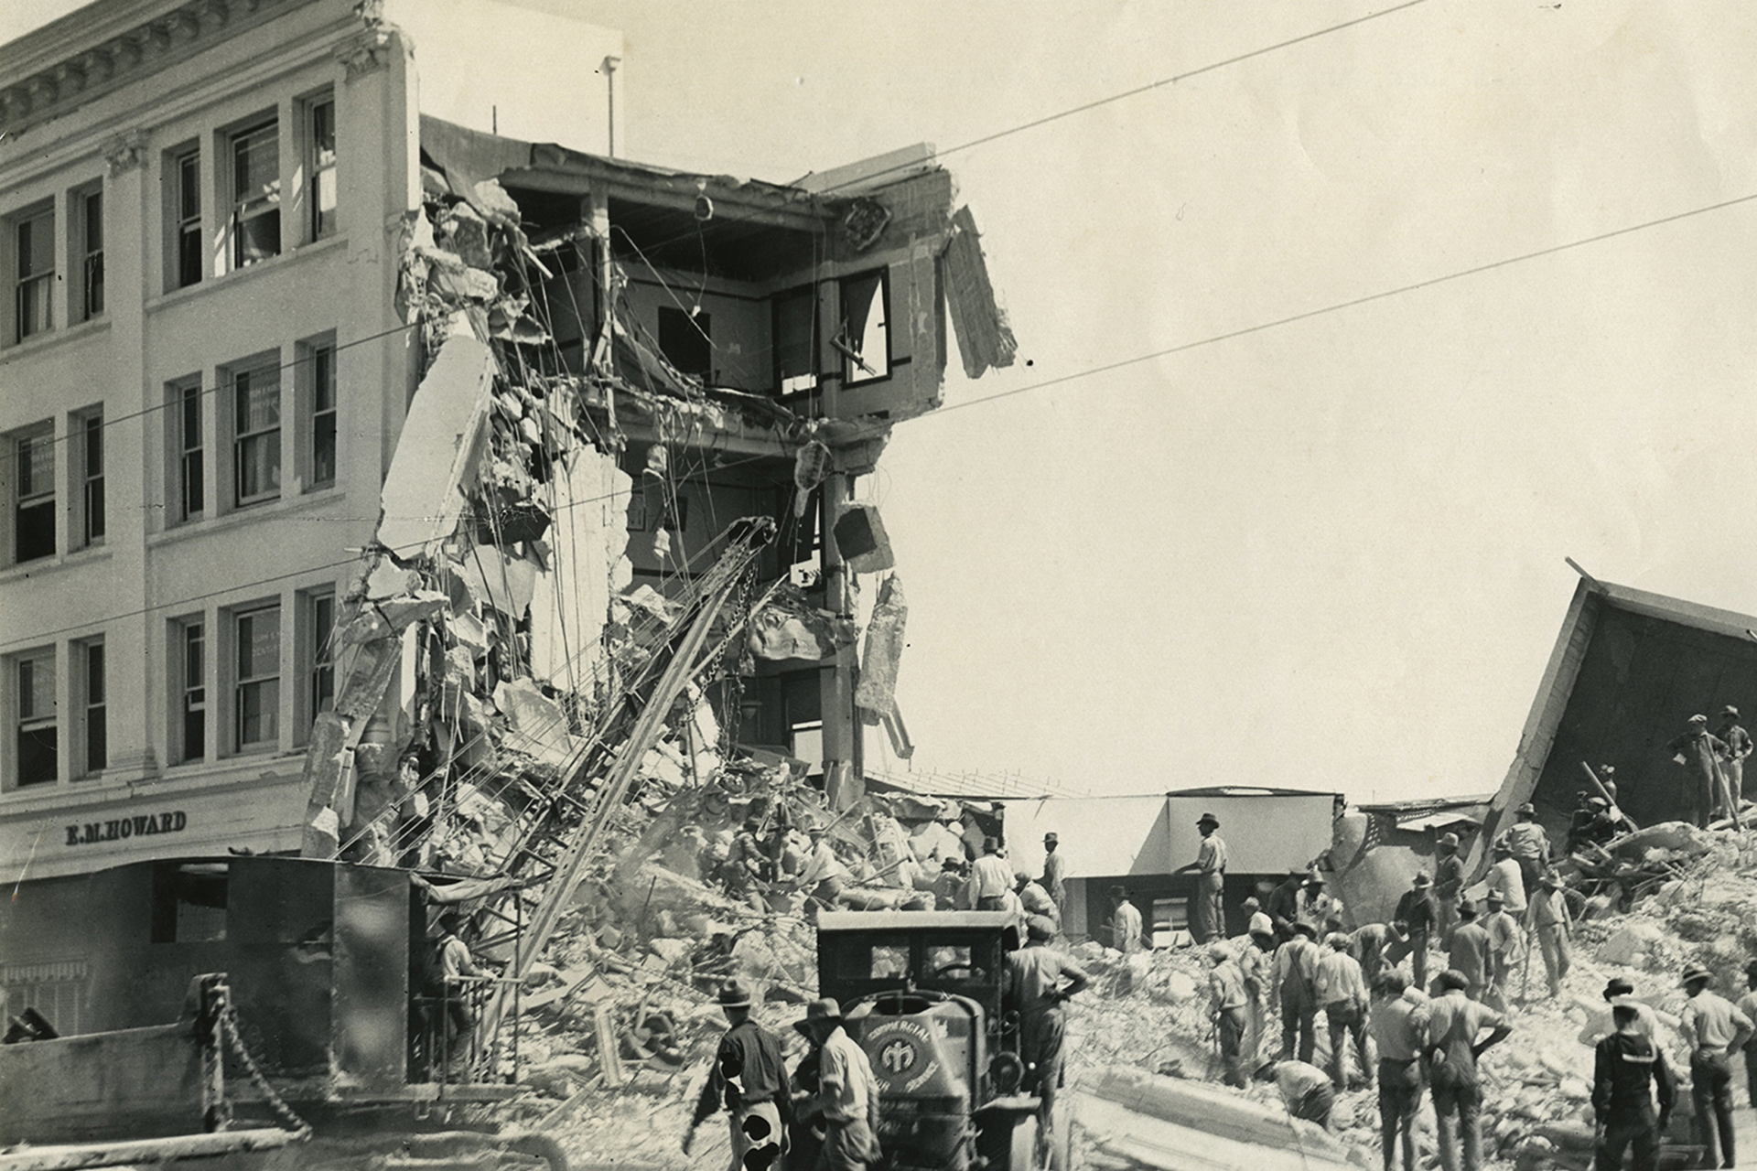
Conclusion
1925 Santa Barbara 6.8
13 killed 8 Million dollars in damage
Santa Barbara Historical Museum

Slide 12
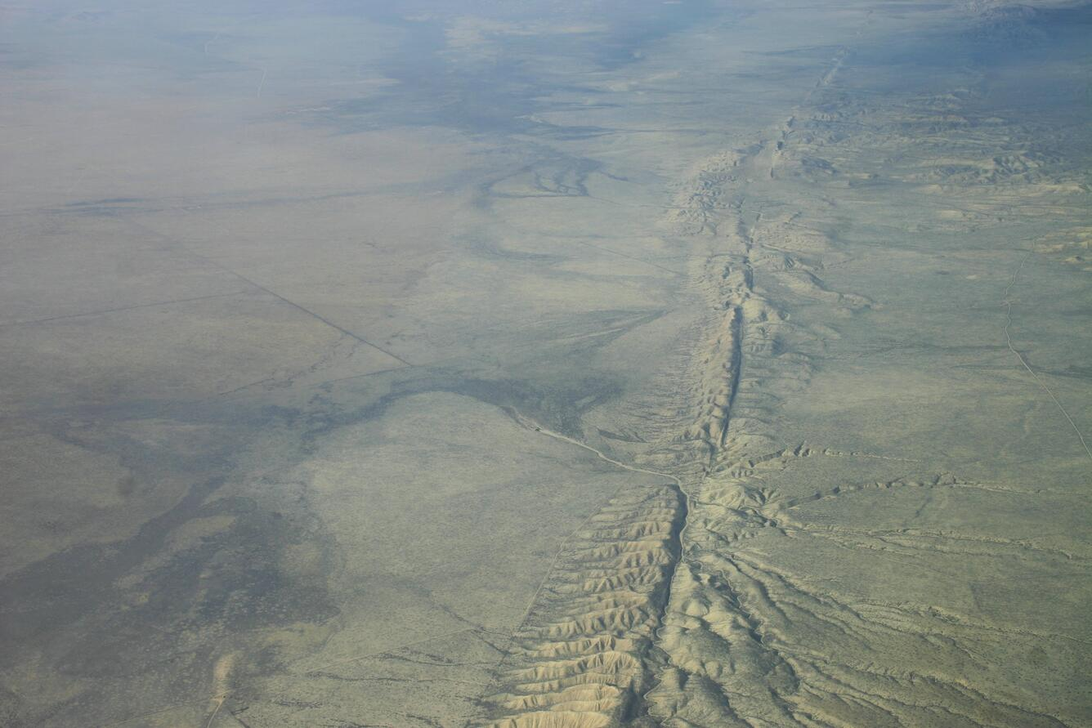
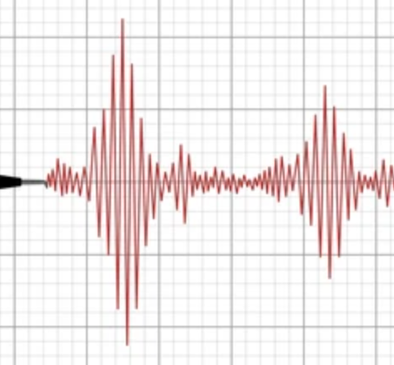
Works Cited
San Andreas Fault, aerial view
Southern California Earthquake Center https://southern.scec.org/article/823
Callifornia Department of Conservation, https://www.conservation.ca.gov/index/Pages/CA-big-quakes.aspx
USGS.gov
dreamstime.com
USGS.gov

